Slide 1
Sharing common assemblies between processes and domains
Article: https://habrahabr.ru/post/341950/
Source code: https://github.com/sflusov/IISSharingAssemblies

Slide 2
The presentation target
Optimization path
Tools for analyzing
Used tools
Sysinternals Process Explorer v16.21
Sysinternals VMMap v3.21

Slide 3
Agenda
Memory structure and types
Sharing assemblies between application domains
Sharing assemblies between processes
Real example

Slide 4
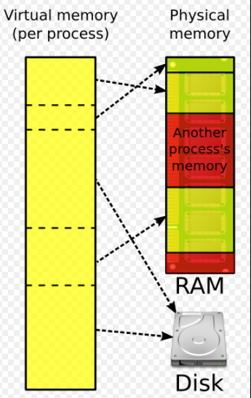
What do you really mean by memory?
Virtual memory:
32-bit - 2GB per process
64-bit – 128TB per process
See also:
http://blogs.microsoft.co.il/sasha/2016/01/05/windows-process-memory-usage-demystified/

Slide 5
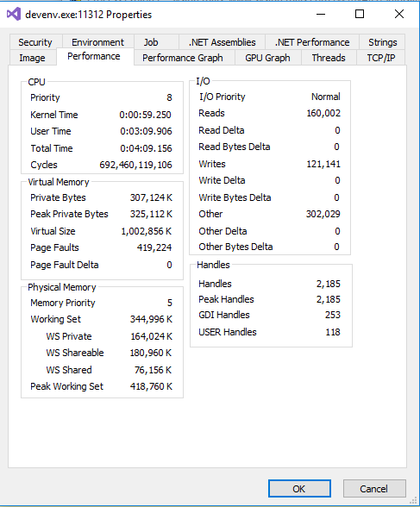
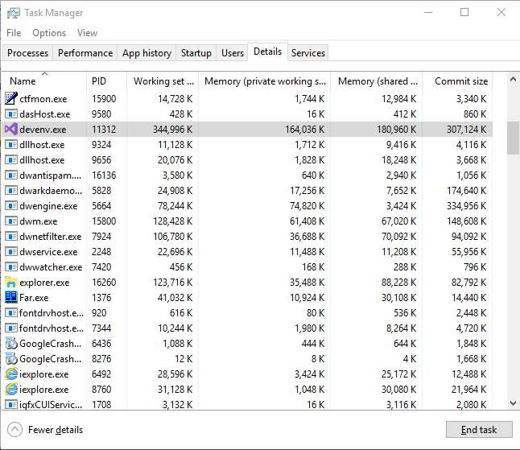
What do you really mean by memory?
Process Explorer
Working Set = WS Private + WS Shareable

Slide 6
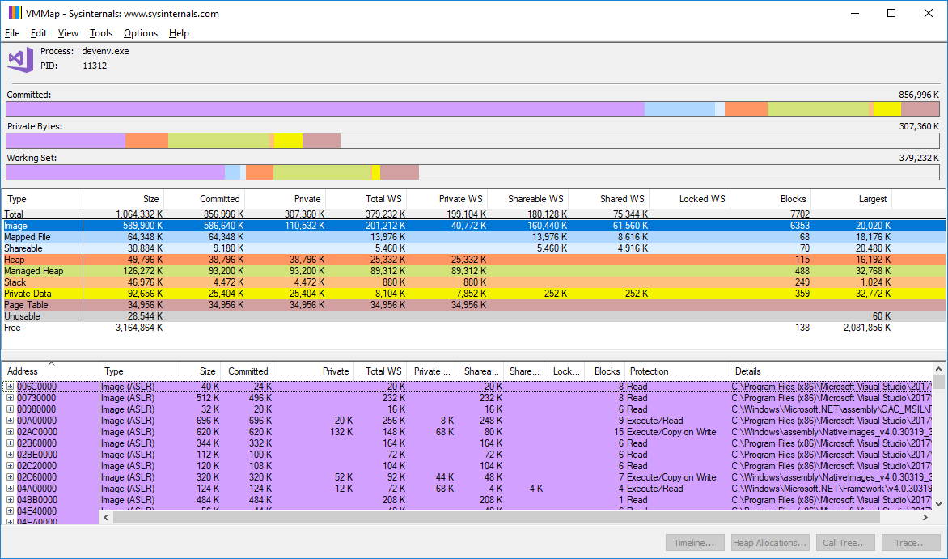
What do you really mean by memory?
See also:
http://blogs.microsoft.co.il/sasha/2016/01/05/windows-process-memory-usage-demystified/
Windows® Sysinternals Administrator’s Reference. Pages 216-218

Slide 7
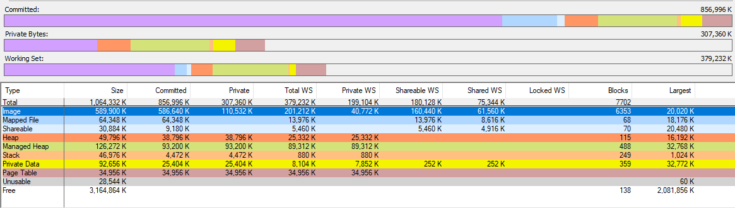
What do you really mean by memory?
See also:
http://blogs.microsoft.co.il/sasha/2016/01/05/windows-process-memory-usage-demystified/
Windows® Sysinternals Administrator’s Reference. Pages 216-218

Slide 8
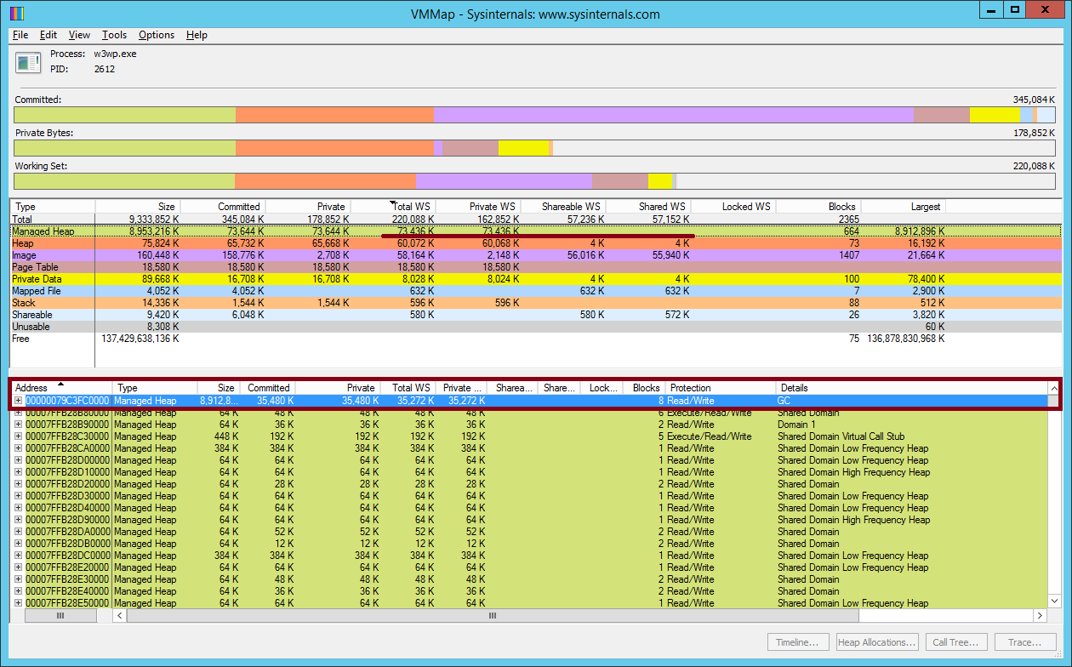

Slide 9
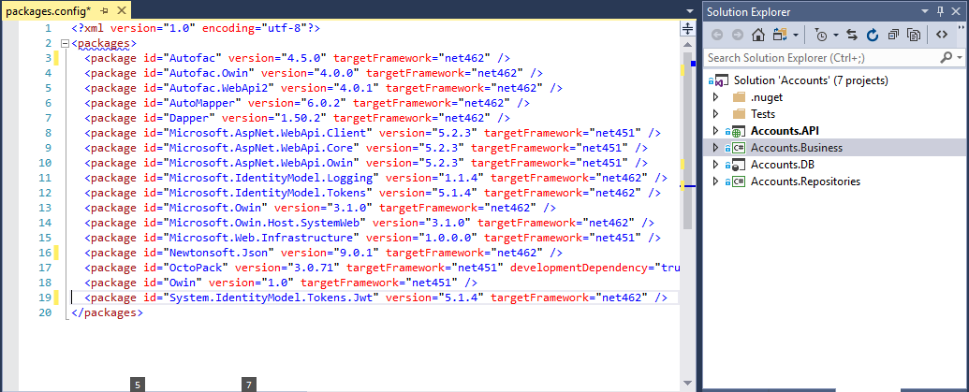
The structure of typical application

Slide 10
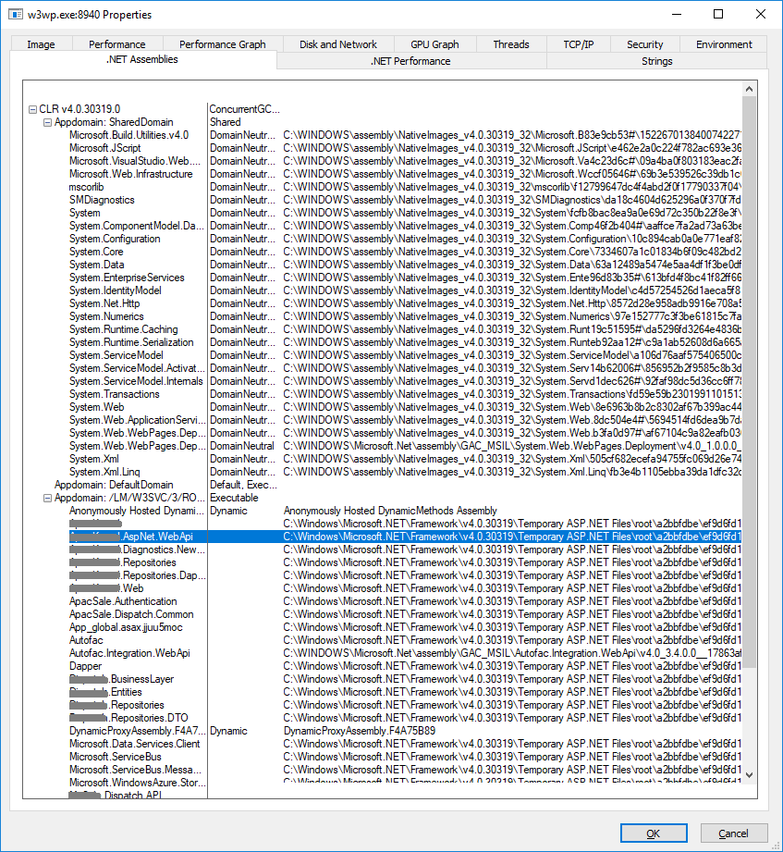
Sharing assemblies between application domains
Domain neutral assembly
It lives across multiple appdomains
It will be jitted only once
The jitted code will be shared across appdomains
See also:
https://blogs.msdn.microsoft.com/junfeng/2004/08/05/domain-neutral-assemblies/
Notes:
Have a look simulation
Have a look real example on MP server

Slide 11
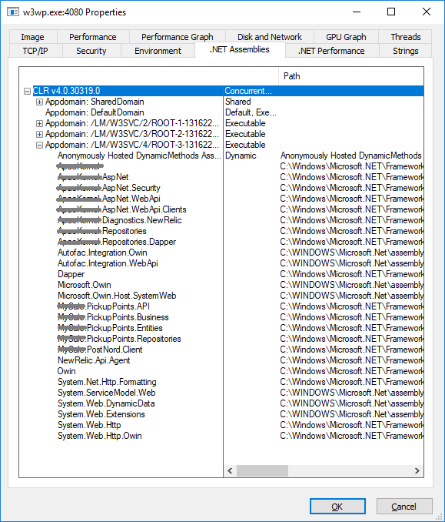
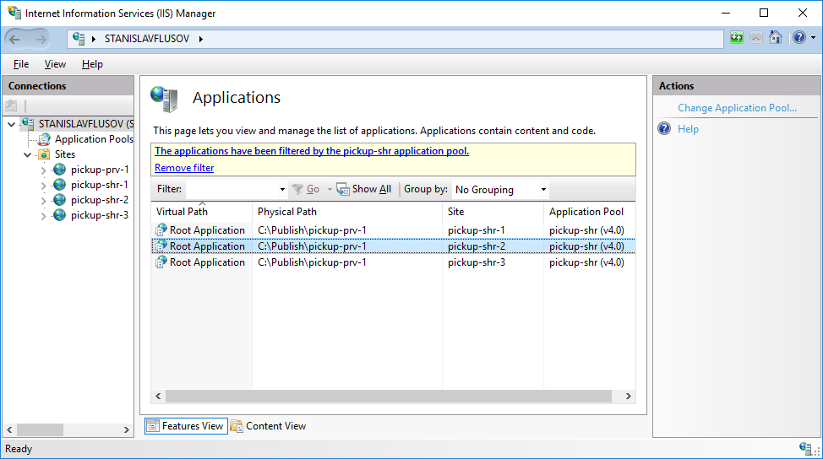
Sharing assemblies between application domains
Notes:
Have a look simulation
Have a look real example on MP server

Slide 12
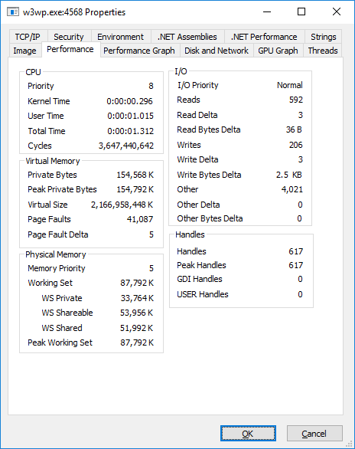

Sharing assemblies between application domains
One site in appPool
Three sites in appPool
Notes:
Have a look simulation
Have a look real example on MP server

Slide 13
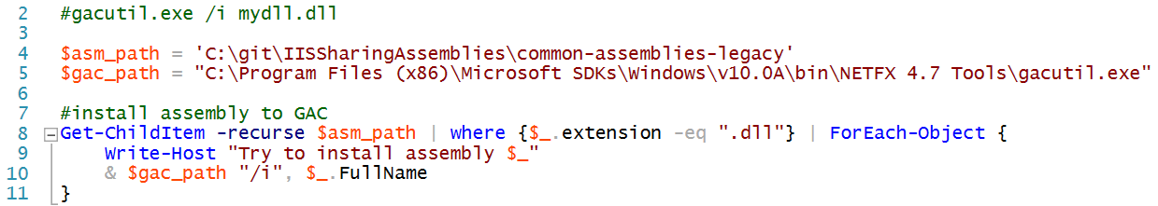
Sharing assemblies between application domains Installing assemblies to GAC

Slide 14
Sharing assemblies between processes
Summary of usage NGEN
Enable code sharing between processes
Require a smaller initial working set
Load faster than MSIL
See also:
https://docs.microsoft.com/en-us/dotnet/framework/tools/ngen-exe-native-image-generator

Slide 15
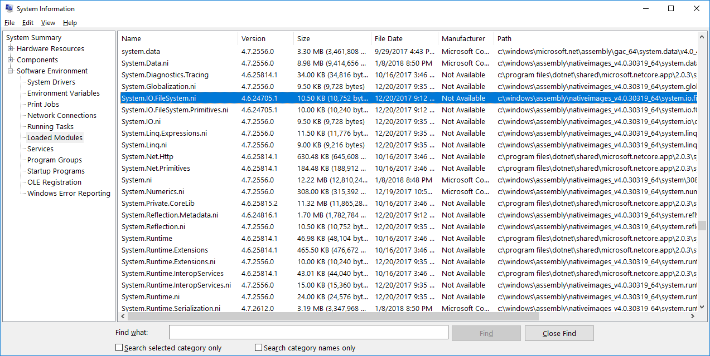
Sharing assemblies between processes

Slide 16
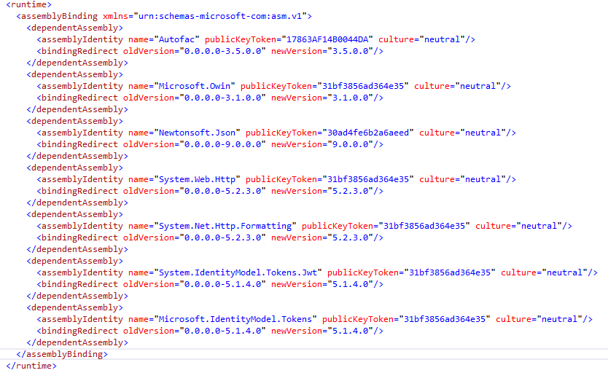
Sharing assemblies between processes

Slide 17
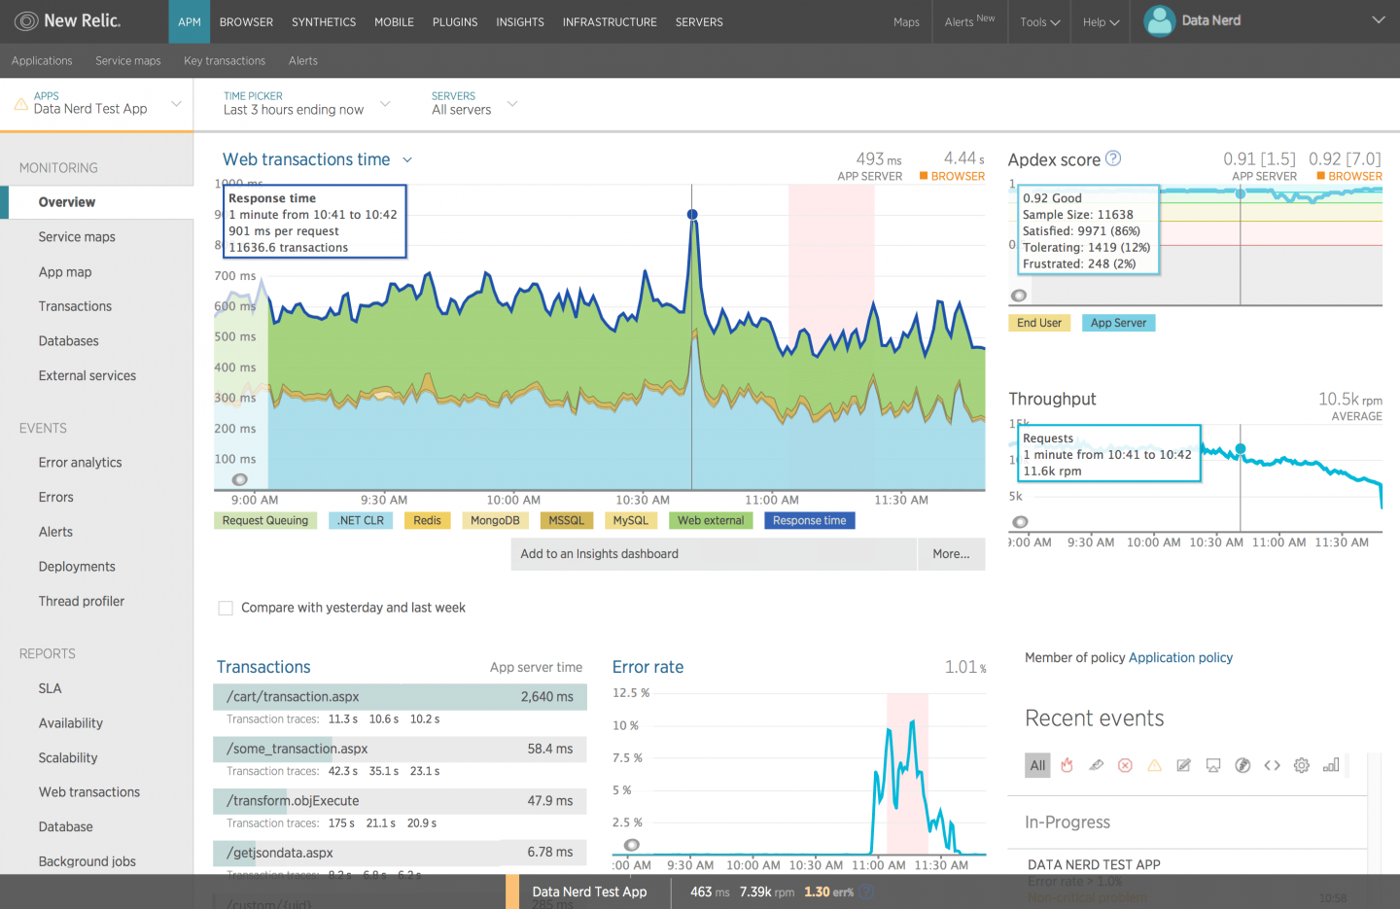
New Relic: Digital Performance Monitoring and Management

Slide 18
Summary
Step | Warming time | Total memory usage | Average memory usage per service
Initial conditions ** | 6 min 43 sec | 8 GB | 7 GB / 47 = 152 Mb
1. App pools combining 2. Load lib to GAC ** | 3 min 20 sec | 3.5 GB | 2.5 GB / 47 = 54 Mb
1. App pools combining 2. Load lib to GAC 3. Make native images | 1 min 57 sec | 2.0 GB | 1.0 GB / 47 = 22 Mb
Remarks:
* There are some deviations in values, because screenshot was made at different time
** NewRelic agent installed

Slide 19
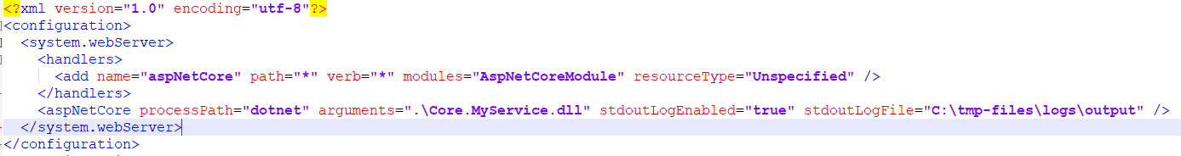
.NET Core & .NET Standard
See also:
https://github.com/dotnet/standard/blob/23ee76bbcd4997c199472a95a9d01f1a74f98e94/docs/faq.md
Notes:
Have a look simulation
Have a look real example on MP server

Slide 20
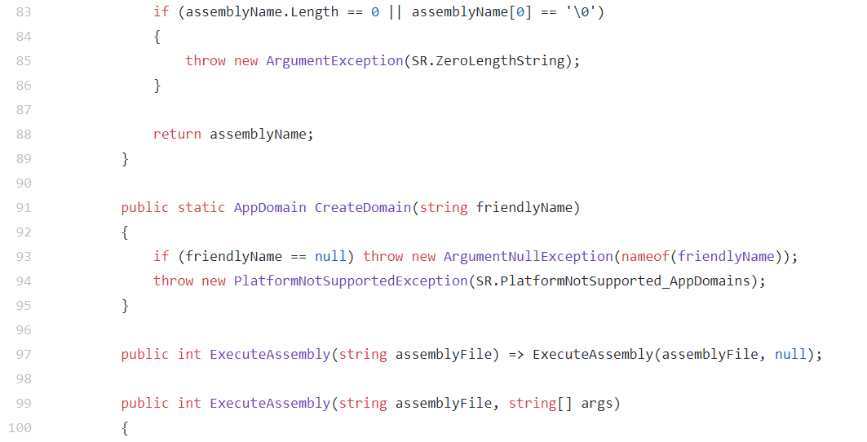
.NET Core & .NET Standard
See also:
https://github.com/dotnet/standard/blob/23ee76bbcd4997c199472a95a9d01f1a74f98e94/docs/faq.md
Notes:
Have a look simulation
Have a look real example on MP server

Slide 21
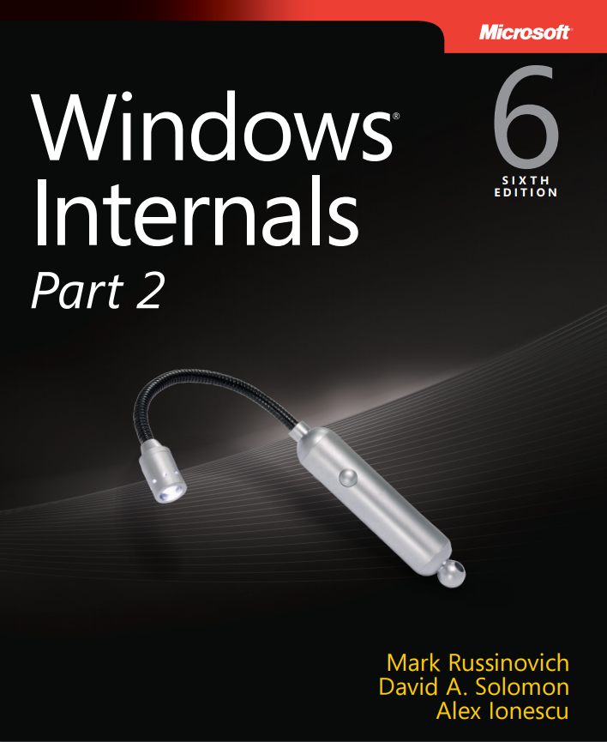
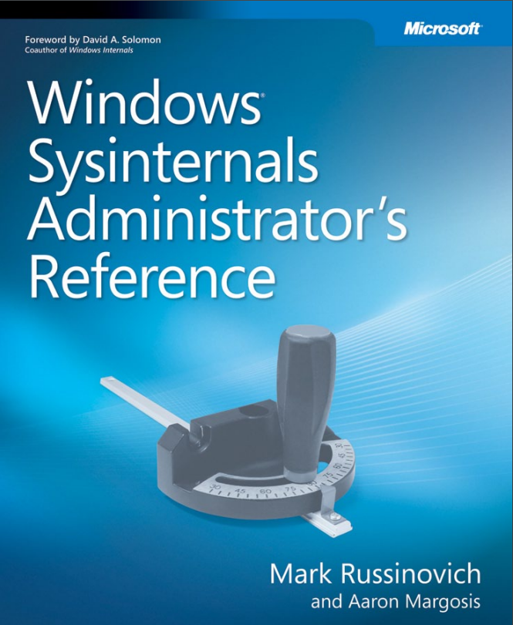
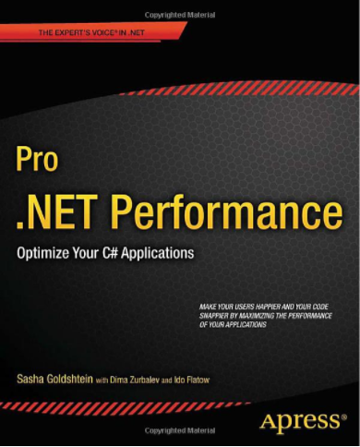
Books recommended for reading
References
https://www.microsoftpressstore.com/store/windows-internals-part-1-9780735648739
https://www.microsoftpressstore.com/store/windows-sysinternals-administrators-reference-9780735656727
http://www.apress.com/us/book/9781430244585

Slide 22
Thank you
Article: https://habrahabr.ru/post/341950/
Source code: https://github.com/sflusov/IISSharingAssemblies
VK: https://vk.com/stanislav_flusov

